Slide 1
Parental Engagement
Lessons from research

Slide 2
Why is it important?
SER (2000)suggests that the relative influence of the home on student achievement is between 60-80%
Hattie (2008) states 70% of student achievement is attributed to what they bring with them to school – their innate ability, their attitudes, their socio-economic status, the amount of television they watch etc.
Plowden report (1967) asserted that schools make little difference to student outcomes.

Slide 3
What difference can it make?
Higher grades
Enrolment in higher level programs/advanced classes
Higher graduatation rates
Higher tertiary education enrolments
Better social skills
Improved behaviour
Regular school attendance
Greater engagement in school work

Slide 4
Economic modelling
Parental effort compared with school resources was equivalent to $1000 extra funding per student
Or
Equivalent to an additional 4-6 years of education for parents.

Slide 5
Parent engagement versus parent involvement
Big difference between involving parents in schooling and involving parents in learning
Whilst parental engagement does clearly affect student academic attainment, parental involvement has very little effect
Some types of parental involvement can actually have a negative effect
The surveillance approach (monitoring student homework)
Controlling and disciplining parental style

Slide 6
Effective Parental Engagement
3 main principles
Academic socialisation
Parental role construction
Parenting style

Slide 7
Academic Socialisation
Communicating with children about parental expectations for education and the value and enjoyment of learning
Discussing learning strategies with children
Linking schoolwork to current events and other topics
Providing a stimulating home learning environment
Making learning enjoyable and rewarding
Focusing on activities such as decision-making and problem solving, affirming their autonomy and independence.

Slide 8
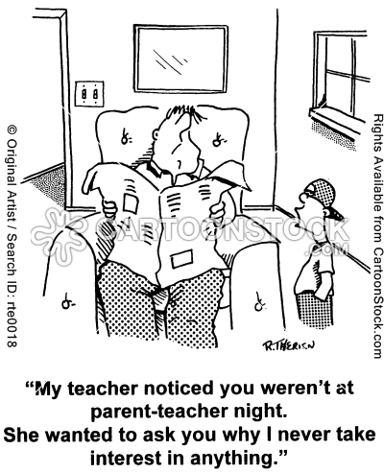

Slide 9
Parental Role Construction
How you perceive your role in your child’s education
Beliefs about appropriate and desirable child outcomes
Beliefs about who is responsible for these outcomes
Belief in your ability to help
Perceptions about what teachers, friends and family expect from you

Slide 10
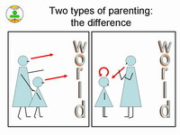

Slide 11
Parenting Style
Supportive
Encourages conversation
Make reasons behind rules transparent
Acknowledge responsibility of child
Conversely
Emotionally distant yet high expectations can lead to low levels of self esteem which can flow on to negative impact on academic acheivement

Slide 12
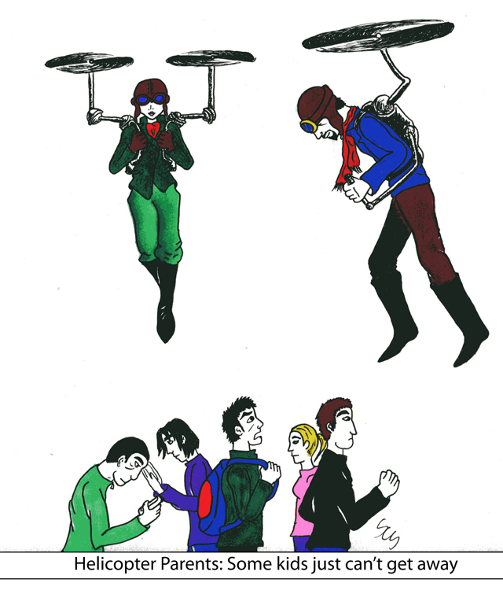

Slide 13
Excessive pressure on a student to excel may be detrimental to their well-being
All parental engagement should be first and foremost about enhancing student well-being.

Slide 15
Summary
Parents do not need to invest a significant amount of time or acquire specialised knowledge in order to assist their child in learning.
Good at-home parenting is effective
Demonstrate a genuine interest in their learning
Setting up a designated area for homework
Provide educational resources
Discussing subject choices, academic aspirations
Talking to them about their school, films, books

Slide 16
Great questions to ask
What do you know now that you didn’t know this morning?

Slide 17
Which story did your teacher read to the class today?
What was your favourite part of the story?
What was the hardest thing you had to do today?
What are you looking forward to at school tomorrow?
What has been your most favourite activity this week?
What was your favourite part of your day?
Did you get frustrated with anything at school today?
Were you able to finish all of your work today?
Do you have any questions that maybe your teacher couldn’t answer?
Is there anything that you are learning in class that you would like to know more about?

Slide 18
Summary continued…..
Actively getting involved with their learning, taking them to museums, exhibitions etc
Open dialogue between school and home
Read newsletters, email teachers and find out what they are learning about in class.
Know what is going on at school
Trust between home and school is vital

Slide 19
Any questions????

